Slide 1
Wind Energy Regulations
Committee on Planning and Development – November 19, 2019

Slide 2
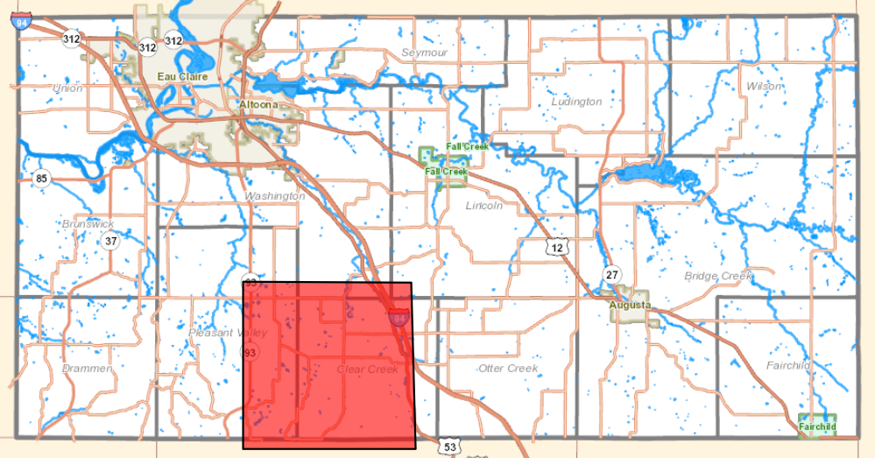
Possible Wind Farm Proposal
Eau Claire County
Wind farm proposal in the towns of Clear Creek and Pleasant Valley.
At this time, no requests for permits have been filed with the planning and development department or the Wisconsin Public Service Commission.
Town of Clear Creek enacted a moratorium on November 11, 2019

Slide 3
County Wind Energy Systems Ordinance
Eau Claire County Code - Section 18.30.260
Current Standards Cover the following:
  Existing ordinance standards adopted prior to the adoption of Wis. Stats. 66.0401 and Chapter PSC 128 Wis. Admin. Code (Wind Energy Systems).
  Title 18 is currently being rewritten to bring the entire code up to date.
    St. Croix County - regulate wind energy systems as defined by Wis. Stats. 66.0403 with a conditional use permit.
    Setbacks
    Spacing and density
    Shadow flicker
    Noise
    Construction standards
    Height
    Access
    Blade Clearance
    Electrical Wires
    Lighting
    Appearance, color, and finish
    Equipment
    Signs
    Land Disturbance
    Parking areas and driveways
    Code Compliance
    Signal Interference
    Abandonment

Slide 4
Administrative Code
2009 Wisconsin Act 40
  Directed the Public Service Commission (PSC) to promulgate administrative rules (PSC 128)
    Commission adopted the final wind siting rules on December 27, 2010
    If a local political subdivision chooses to regulate wind energy systems –
      Its regulations may not be more restrictive than the PSC rules.
    Ensure consistent local procedures for local regulation of wind energy system.
  Wis. Admin. Code ch. 128 Wind Energy Systems –
    Effective date March 16, 2012
  PSC 128.03 Political subdivision authority – limits local authority
    PSC 128 Wis. Admin. Code: A political subdivision may not place any restriction, either directly or in effect, on the installation or sue of a wind energy system except by adopting an ordinance that complies with this chapter and Wis. Stats. 66.0401, and is not more restrictive than this chapter.
  PSC 128.13 Siting Criteria
    A political subdivision may not establish long-term land use planning requirements or practices that preclude the construction of a particular type, or any type, of wind turbine or wind energy system within the political subdivision’s jurisdiction.
    Source: PSC of Wisconsin Wind Siting Rules website, 2009 Wisconsin Act 40, PSC 128 Wis. Admin. Code

Slide 5
Wisconsin Statutes
Wis. Stats. 66.0401 Regulations relating to solar and wind energy systems
  Wis. Stats. 66.0401 (1m) Authority to restrict systems limited. No political subdivision may place any restriction, either directly or in effect, on the installation or use of a wind energy system that is more restrictive than the rules promulgated by the commission under s. 196.378 (4g) (b). No political subdivision may place any restriction, either directly or in effect, on the installation or use of a solar energy system, as defined in s. 13.48 (2) (h) 1. g., or a wind energy system, unless the restriction satisfies one of the following conditions:
(a) Serves to preserve or protect the public health or safety.
(b) Does not significantly increase the cost of the system or significantly decrease its efficiency.
(c) Allows for an alternative system of comparable cost and efficiency.
Source: Wisconsin Statutes

Slide 6
Wisconsin Statutes cont.
  Wis. Stats. 66.0403 Solar and Wind Access Permits
  Wis. Stats. 196.491 Strategic Energy Assessment; Electric Generating Facilities and Transmission lines: Natural Gas Lines.
    PSC authority to regulate wind energy systems with an operational capacity of 100 megawatts (MW) or greater

Slide 7
Certificate of Public Convenience and Necessity (CPCN)
Wis. Stats. 196.491 (3) CPCN - Required for Large electric generating facility – operation capacity of 100 megawatts or more.
Statutory Review Process – Review by the PSC and approval by the Commission.
  Application Filing Requirement Wind Energy Projects – October 2017
    PSC/DNR Consultation Process
    Source: Wis. Stats. 196.491

Slide 8
Wisconsin Department of Natural Resources (WDNR)
WDNR and PSC – cooperative agreement – ensures both agencies share information and make timely decisions.
WDNR’s main responsibilities
  Wetland and waterway crossings permitting
  Construction site erosion control
  Protection of state-listed threatened species
  Bird and bat impacts
Source: WDNR Wind Power Webpage

Slide 9
Applicable Local Ordinances
Conditional Use Permit:
“MET tower” means a tower, including any anchor, base, base plate, boom, cable, electrical or electronic equipment, guy wire, hardware, indicator, instrument, telemetry device, vane, or wiring, that is used to collect or transmit meteorological data, including wind speed and wind flow information, in order to monitor or characterize wind resources at or near a wind energy system.
Wind Energy Systems less than 100 megawatts (MW).

Slide 10
Applicable Local Ordinances cont.
Other applicable local (town/county) ordinances may include the following:
Road limits (Road use agreements)
Crossing and access permits (could be for utilities)
Noise abatement ordinances (hours or times of construction)
Building permits
Driveway access permits and culvert approval, and
Erosion and stormwater permitting.

