Slide 1
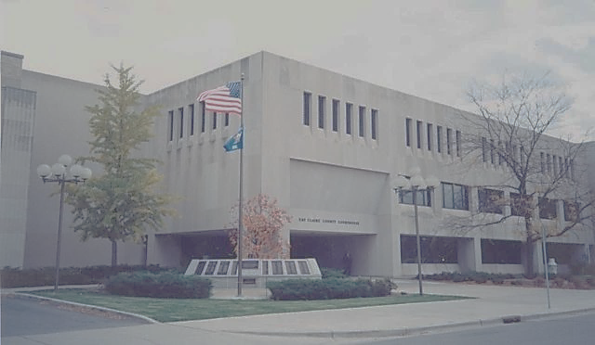
Joint Committee Meeting:
Highway and Finance & Budget
June 06, 2018

Slide 2
. .
Priority assigned by constituency (yearly budget survey):
Question: Importance of maintaining state and county highway system.
The average rating is 4.41 (out of 5)
Third priority of residents after operation of 911 and patrol and crime investigation.
. . . and the Survey says…

Slide 3
1. What is an acceptable PASER rating for Eau Claire County roads? 2. What is an acceptable investment into year over year investment? 3. What should be the source of funding?
Decision Points

Slide 4
Current average = 5.4.
Capital Investment needed to retain 5.4 PASER rating is 4.9M.
Current goal is an average of 6. Annual capital improvement to achieve this rating is 6.25M for 8-10 years depending.
Shortfall of $ 320,000 for maintenance.
PASER RATING
Current Maintenance Funding
Levy | $1.78
GTA | $3
Total: | $4.78
Needed Maintenance Funding
Winter | $0.80
Summer | $4.3
Total: | $5.1

Slide 5
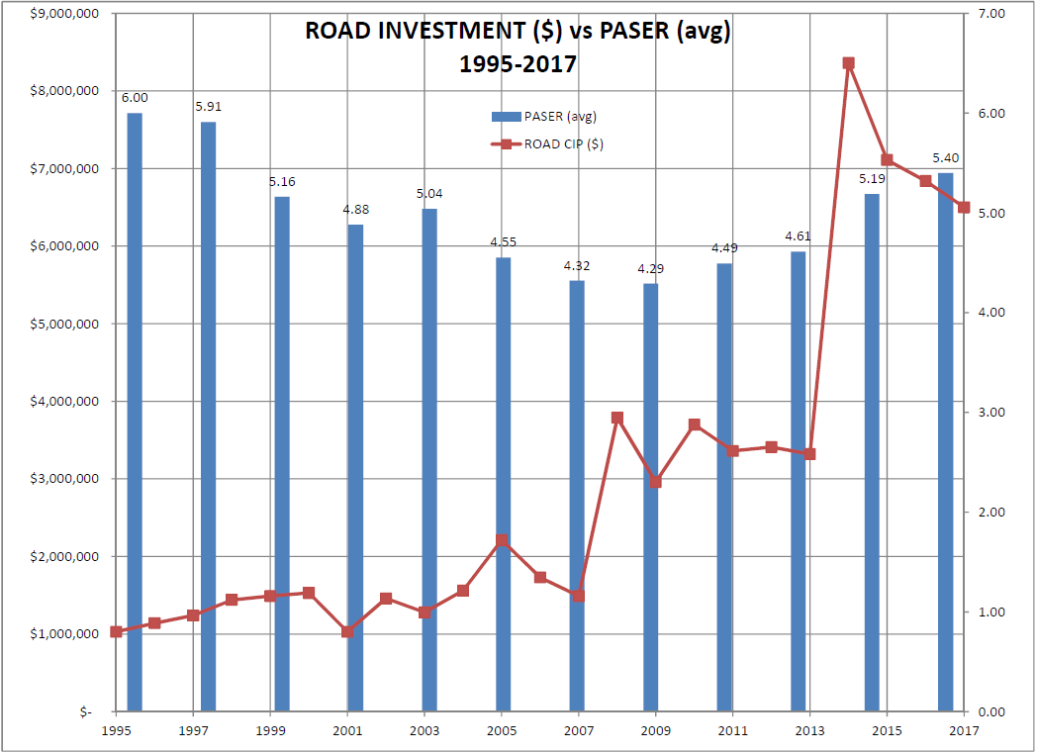

Slide 6
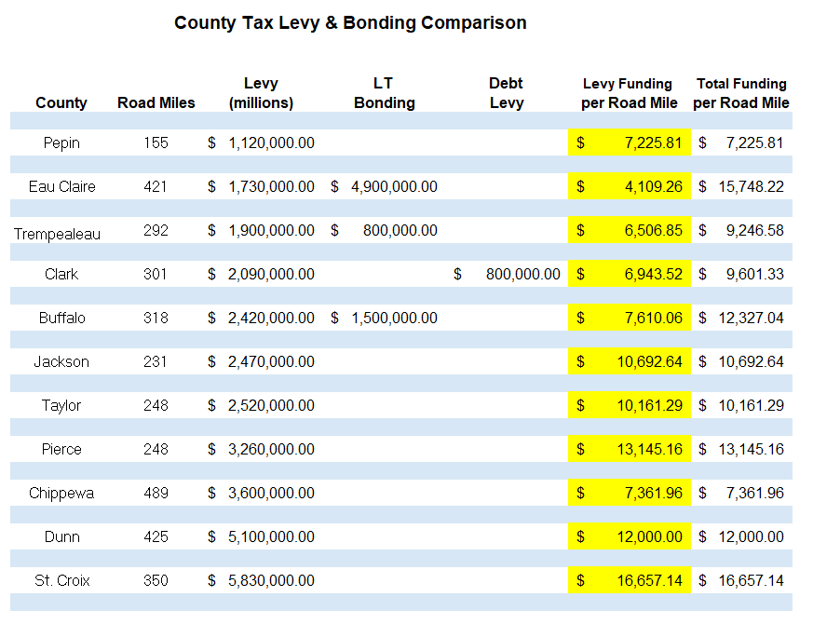

Slide 7
What the data is telling us
Other counties utilize significantly more levy (operational)
 | Levy Funding per Road Mile | Total Funding per Road Mile
Mean | $9,310.31 | $11,287.92
Median | $7,610.06 | $10,692.64
ECC | $4,109.26 | $15,748.22

Slide 8
Issue statement: Current funding model is unsustainable for continued investment into highway infrastructure.
Reliance on Debt
Debt policy – 30%
Debt repayment schedule
Moody’s rating scale of debt: investment grade opinions of the relative credit risk of fixed- income obligations.
Moody’s indicated that ECC needed to “identify strategies to mitigate long-term reliance on debt.”
FUNDING

Slide 9
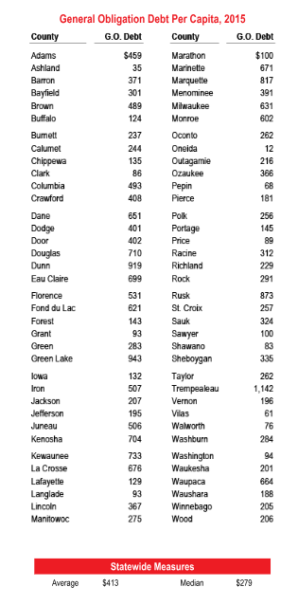
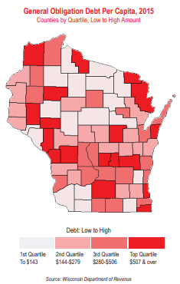
Debt Benchmark

Slide 10
Debt Policy
** Est % Increase in New Const. – 2%**
 | 2019 | 2020 | 2021 | 2022 | 2023
Existing Debt Service | 9,196,380 | 9,179,930 | 9,182,380 | 9,186,915 | 9,274,293
FUTURE DEBT SERVICE
2018 Borrowing | 1,128,562 | 1,128,562 | 1,128,562 | 1,128,562 | 1,128,562
2019 Borrowing |  | 1,499,286 | 1,499,286 | 1,499,286 | 1,499,286
2020 Borrowing |  |  | 776,788 | 776,788 | 776,788
2021 Borrowing |  |  |  | 830,204 | 830,204
2022 Borrowing |  |  |  |  | 841,344
2023 Borrowing
Total Est Debt Service Pmt | 10,324,943 | 11,807,779 | 12,587,017 | 13,421,756 | 14,350,478
Est Operating Levy | 22,380,622 | 23,848,234 | 24,325,199 | 24,811,703 | 25,307,937
Total County Levy | 33,705,565 | 35,656,013 | 36,912,216 | 38,233,456 | 39,658,415
Debt Service Levy % | 30.63 | 33.12 | 34.10 | 35.10 | 36.19
Current Year Borrowing | 13,121,845 | 6,798,500 | 7,266,000 | 7,363,500 | 8,453,500

Slide 11
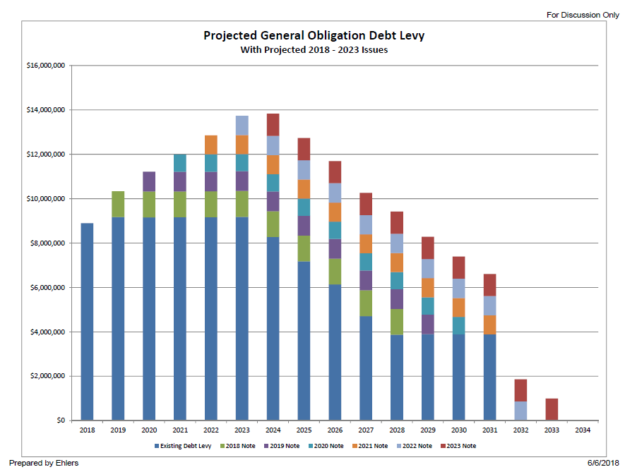
Debt – Based on capital plan

Slide 12
&
Operations
Capital
Uses:
Day-to-day expenses
Funding Sources:
Tax levy
Sales tax
Grants and Aids
Service Fees
Limits
Percentage of net new construction or zero, whichever is greater
SOURCES
Uses:
Long-term investment
Real property
Infrastructure
Major software systems
Funding Sources:
Bonding (Debt)
Fund balance
Limits
Policy Decision on taxpayers ability to pay and desired debt load

Slide 13
Revenue Source options
Property Tax Realignment
Internal adjustments to levy dollars will result in loss of other county services
Levy funds for the Highway department are at the same now as they were in 1984
Eau Claire County Highway has the lowest levy funding department in the region by road mile
If realigned within Highway, road & bridge construction projects would take longer
Fund Balance Transfers
Continuing to deplete General Fund Balance is not a viable long-term approach as it will negatively impact the County’s bond rating score and decrease future cash flow options
Not a sustainable option—kicking the can down the road not planning for the future
Bonding/Borrowing
County has transportation plan that relies completely on bonding for road & bridge improvements – Not a sustainable option
Bonding amounts have gone from 6.8M in 2017 to 4.8M in 2018
Eau Claire County has the highest bond issuance for highway improvements in the region making it the highest funding level per mile based on bonding

Slide 14
Revenue Source options continued…
Levy Referendum
Increasing the Property Tax Levy would require a binding levy referendum approved by voters
Sales Tax
Sales tax revenue be used for capital improvement
Local Vehicle Registration Fee
Anticipated Revenue $2,393,610 based on a $30.00 user fee in Eau Claire County
Estimate based on 79787 vehicles registered within County
DMV charges $0.17/vehicle registration
Most politically flexible option
Requires 3 month implementation period (DMV)
Provides an additional & reliable funding source
Road users will pay more for using roads (direct correlation)
Funds must be used for transportation

Slide 15
Capital plan - Opportunity costs
We utilize capital debt for more than highway.
Of the $13 million requested for 2019, $4.9 million is Highway.
Transitioning a portion ($2.3 million) of highway to a source other than borrowing has a 10 year savings of $3,827,850 in interest not paid, and issuance cost savings.
$2.3 million is based on $30 vehicle registration fee.
 | 2019 | 2020 | 2021 | 2022 | 2023
TOTALS: | $14,441,865 | $6,798,500 | $7,266,000 | $7,363,500 | $8,456,500
Estimated Annual Borrowing | $13,124,845 | $6,798,500 | $7,266,000 | $7,363,500 | $8,456,500

Slide 16
RECOMENDATIONS

